Slide 1



Noida Institute of Engineering and Technology, Greater Noida
Introduction to Computer Networks
Unit: 1
Computer Networks
Ms. Akanksha
Asst. Professor
B Tech 5th Sem

Slide 2
Contents
Evaluation Scheme
Syllabus
Branch wise syllabus
Course Objective
Course Outcome
Program Outcome
CO-PO Mapping
PSO
CO- PSO Mapping
PEO
Result analysis
Paper template
Prerequisites
Introduction to subject
Unit objective
Topic objective
Goals and applications of networks
Categories of networks
Organization of the Internet, ISP
Network structure and architecture (layering, services, protocols and standards)
The OSI reference model
TCP/IP protocol suite
Network devices and components
Physical Layer: Network topology design
Types of connections
Transmission media
Signal transmission and encoding
Network performance and transmission impairments
Switching techniques and multiplexing.

Slide 3
Contents
Video Links
Daily Quiz
Weekly Assignment
MCQs
Expected Questions in University Exams
Summary
References

Slide 4

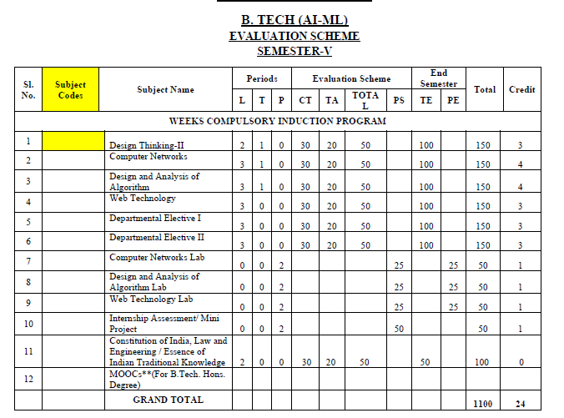
Evaluation Scheme

Slide 5
Syllabus
Unit | Topic
I | Introductory Concepts: Goals and applications of networks, Categories of networks, Organization of the Internet, ISP, Network structure and architecture (layering, services, protocols and standards), The OSI reference model, TCP/IP protocol suite, Network devices and components. Physical Layer: Network topology design, Types of connections, Transmission media, Signal transmission and encoding, Network performance and transmission impairments, Switching techniques and multiplexing.
II | Link layer: Framing, Error Detection and Correction, Flow control (Elementary Data Link Protocols, Sliding Window protocols). Medium Access Control and Local Area Networks: Channel allocation, Multiple access protocols, LAN standards, Link layer switches & bridges (learning bridge and spanning tree algorithms).
III | Network Layer: Point-to-point networks, Logical addressing, Basic internetworking (IP, CIDR, ARP, RARP, DHCP, ICMP), Routing, forwarding and delivery, Static and dynamic routing, Routing algorithms and protocols, Congestion control algorithms, IPv6.
IV | Transport Layer: Process-to-process delivery, Transport layer protocols (UDP and TCP), Multiplexing, Connection management, Flow control and retransmission, Window management, TCP Congestion control, Quality of service.
V | Application Layer: Domain Name System, World Wide Web and Hyper Text Transfer Protocol, Electronic mail, File Transfer Protocol, Remote login, Network management, Data compression, Cryptography – basic concepts.

Slide 6
Branch wise Applications
Resource Sharing
Server-Client model:
Communication Medium:
Access to remote information
Person-to-person communication
Electronic commerce
Cloud-based Applications
AI and Expert System
Neural Networks and parallel programming
Decision support and office automation systems etc.

Slide 7
Course Objective
To develop an understanding of
To understand computer networking basics.
To understand different components of computer networks.
To study and understand various protocols.
The standard models for the layered approach to communication between autonomous machines in a network.
To study and understand the main characteristics of data transmission across various physical link types.

Slide 8
Course Outcome
At the end of the course, the student will be able
Course Outcomes (CO) |  | Bloom’s Knowledge Level (KL)
CO.1 | Explain basic concepts, OSI reference model, services and role of each layer of OSI model and TCP/IP, networks devices and transmission media, Analog and digital data transmission | K1, K2
CO.2 | Apply channel allocation, framing, error and flow control techniques. | K3
CO.3 | Describe the functions of Network Layer i.e. Logical addressing, subnetting & Routing Mechanism | K2, K3
CO.4 | Explain the different Transport Layer function i.e. Port addressing, Connection Management, Error control and Flow control mechanism. | K2, K3
CO.5 | Explain the functions offered by session and presentation layer and their Implementation. | K2, K3
CO.6 | Explain the different protocols used at application layer i.e. HTTP, SNMP, SMTP, FTP, TELNET and VPN. | K2

Slide 9
Program Outcome
1. Engineering knowledge
2. Problem analysis
3. Design/development of solutions
4. Conduct investigations of complex problems
5. Modern tool usage
6. The engineer and society
7. Environment and sustainability
8. Ethics
9. Individual and team work
10. Communication
11. Project management and finance
12. Life-long learning

Slide 10
CO-PO Mapping
The highlighted text shows the mapping of course outcome with PO mapping of this unit
Computer Networks |  |  |  |  |  |  |  |  | Year of Study: 2022-23
CO | PO1 | PO2 | PO3 | PO4 | PO5 | PO6 | PO7 | PO8 | PO9 | PO10 | PO11 | PO12
CO.1 | 3 | 2 | 3 | 2 | 1 | 1 |  |  |  |  | 2 | 3
CO.2 | 3 | 3 | 2 | 2 | 3 | 2 |  | 1 |  |  | 1 | 3
CO.3 | 3 | 2 | 1 |  | 1 | 2 |  | 1 | 2 |  | 1 | 3
CO.4 | 2 | 2 | 1 |  | 1 |  |  | 1 | 1 |  | 1 | 3
CO.5 | 2 | 2 | 2 |  | 1 |  |  |  |  |  | 1 | 3
CO.6 | 2 | 1 |  |  | 3 | 2 |  | 3 | 1 |  | 1 | 3

Slide 11
Program Specific Outcomes
PSO1: Work as a software developer, database administrator, tester or networking engineer for providing solutions to the real world and industrial problems.
PSO2:Apply core subjects of information technology related to data structure and algorithm, software engineering, web technology, operating system, database and networking to solve complex IT problems.
PSO3: Practice multi-disciplinary and modern computing techniques by lifelong learning to establish innovative career.
PSO4: Work in a team or individual to manage projects with ethical concern to be a successful employee or employer in IT industry.

Slide 12
CO-PSO Mapping
The highlighted text shows the mapping of course outcome with PSO mapping of this unit
CO | PSO1 | PSO2 | PSO3 | PSO4
C603.1 | 3 | 3 | 2 | 1
C603.2 | 3 | 3 | 2 | 1
C603.3 | 3 | 3 | 2 | 1
C603.4 | 3 | 3 | 1 | 1
C603.5 | 3 | 3 | 1 | 1
C603.6 | 3 | 3 | 1 | 1

Slide 13
Program Educational Objectives
PEO1: able to apply sound knowledge in the field of information technology to fulfill the needs of IT industry.
PEO2: able to design innovative and interdisciplinary systems through latest digital technologies.
PEO3: able to inculcate professional and social ethics, team work and leadership for serving the society.
PEO4: able to inculcate lifelong learning in the field of computing for successful career in organizations and R&D sectors.

Slide 14
Result Analysis
Computer Networks Result of 2020-21: 96.97%
Average Marks: 54.33

Slide 15
End Semester Question Paper Template
B TECH
(SEM-V) THEORY EXAMINATION 20__-20__
OBJECT ORIENTED SYSTEM DESIGN
Time: 3 Hours Total Marks: 100
Note: 1. Attempt all Sections. If require any missing data; then choose suitably.
SECTION A
Attempt all questions in brief. 2 x 10 = 20
Q.No. | Question | Marks | CO
1 |  | 2
2 |  | 2
. |  | .
10 |  | 2

Slide 16
End Semester Question Paper Templates
SECTION B
2. Attempt any three of the following: 3 x 10 = 30
SECTION C
3. Attempt any one part of the following: 1 x 10 = 10
Q.No. | Question | Marks | CO
1 |  | 10
2 |  | 10
. |  | .
5 |  | 10
Q.No. | Question | Marks | CO
1 |  | 10
2 |  | 10

Slide 17
End Semester Question Paper Templates
4. Attempt any one part of the following: 1 x 10 = 10
5. Attempt any one part of the following: 1 x 10 = 10
6. Attempt any one part of the following: 1 x 10 = 10
Q.No. | Question | Marks | CO
1 |  | 10
2 |  | 10
Q.No. | Question | Marks | CO
1 |  | 10
2 |  | 10
Q.No. | Question | Marks | CO
1 |  | 10
2 |  | 10

Slide 18
End Semester Question Paper Templates
7. Attempt any one part of the following: 1 x 10 = 10
Q.No. | Question | Marks | CO
1 |  | 10
2 |  | 10

Slide 19
Prerequisite
The student should have knowledge of
Networking
Layout of computer
Hardware
The basic knowledge of C

Slide 20
Brief Introduction to Subject
Computer network is a group of devices connected with each other through a transmission medium such as wires, cables etc.
These devices can be computers, printers, scanners, Fax machines etc.
The purpose of having computer network is to send and receive data stored in other devices over the network.

Slide 21
Topic Mapping with Course Outcome
Topics | Course outcome
Introductory Concepts: Goals and applications of networks. Categories of networks Organization of the Internet, ISP, Network structure and architecture (layering principles, services, protocols and standards), The OSI reference model, TCP/IP protocol suite, Network devices and components. Physical Layer: Network topology design, Types of connections, Transmission media, Signal transmission and encoding, Network performance and transmission impairments, Switching techniques and multiplexing. | CO1 CO1 CO2 CO1 CO1

Slide 22
Communication (CO1)
Topic Objective
The student will get an insight of communications, networking
Medium used for transmission
Various topologies used
The LAN, WAN and MAN concept

Slide 23
Communication (CO1)
For communication we share the information
Data refers to any information
Data communication
exchange of data between two devices by some transmission medium.
Effectiveness of data communication depends on
Delivery
Accuracy
Timeliness
Jitter

Slide 24
Computer Networks (CO1)
A computer network is an interconnection of two or more computers that are able to exchange information
Network is a set of devices connected by communication link
The computer may be connected via any data communication link(Wired/Wireless).
Computers can be personal or main frames.
The computer network may be located anywhere in the world and its size can vary.
Generally we follow a server client model.

Slide 25
Computer network Communication(CO1)
Components
Message – information to be communicated
Sender – a device that sends the data
Receiver – a device that receives the data
Transmission medium – physical path by which message transmits
Protocol – a set of rules that govern data communications
We transmits information or data by two types of signals
Analog – telephones and radios
Digital - computers

Slide 26
Data representation
Text
Bit pattern, sequence of bits
set of bits – code, process is coding
Numbers
Number system
Images
Matrix of pixels
Size of the pixel depends on resolution
Audio
Continuous
Video
Continuous / combination of images

Slide 27
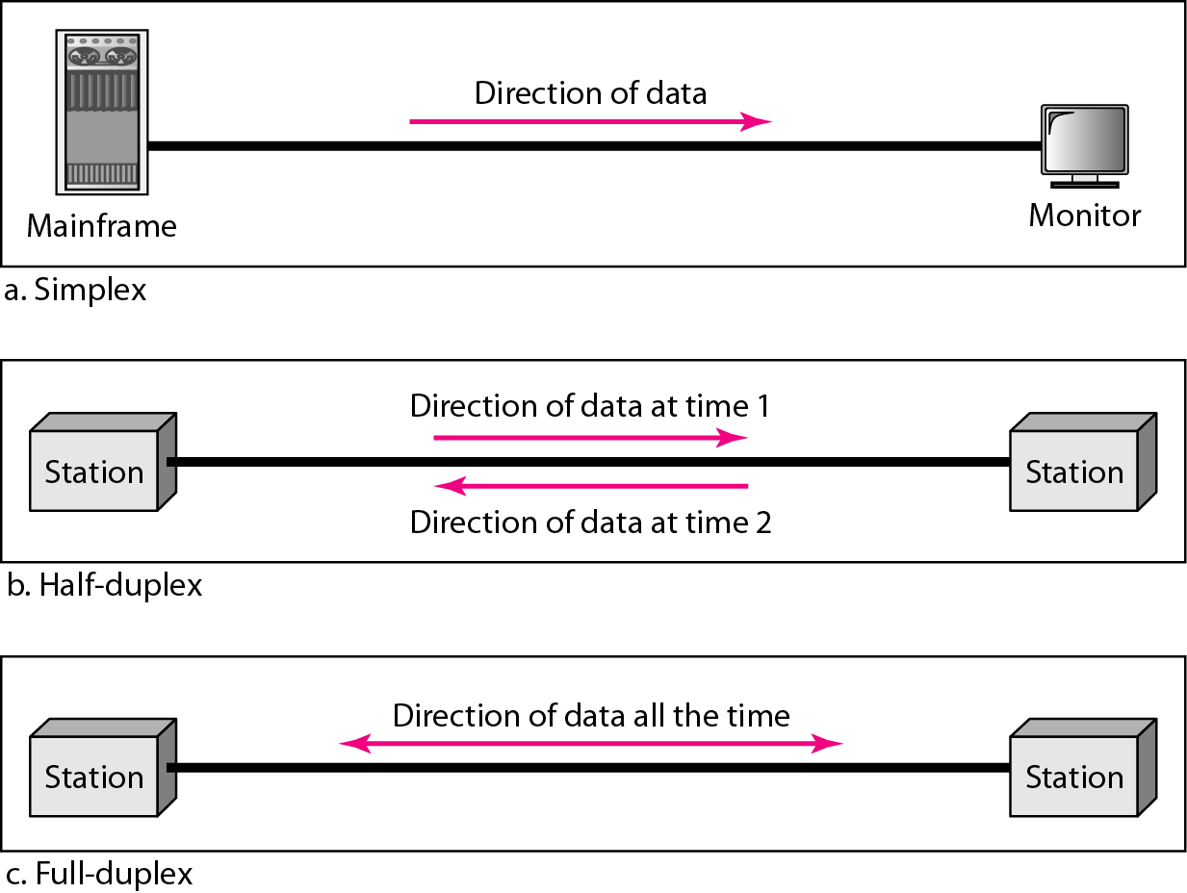
Modes of transmission(CO1)

Slide 28
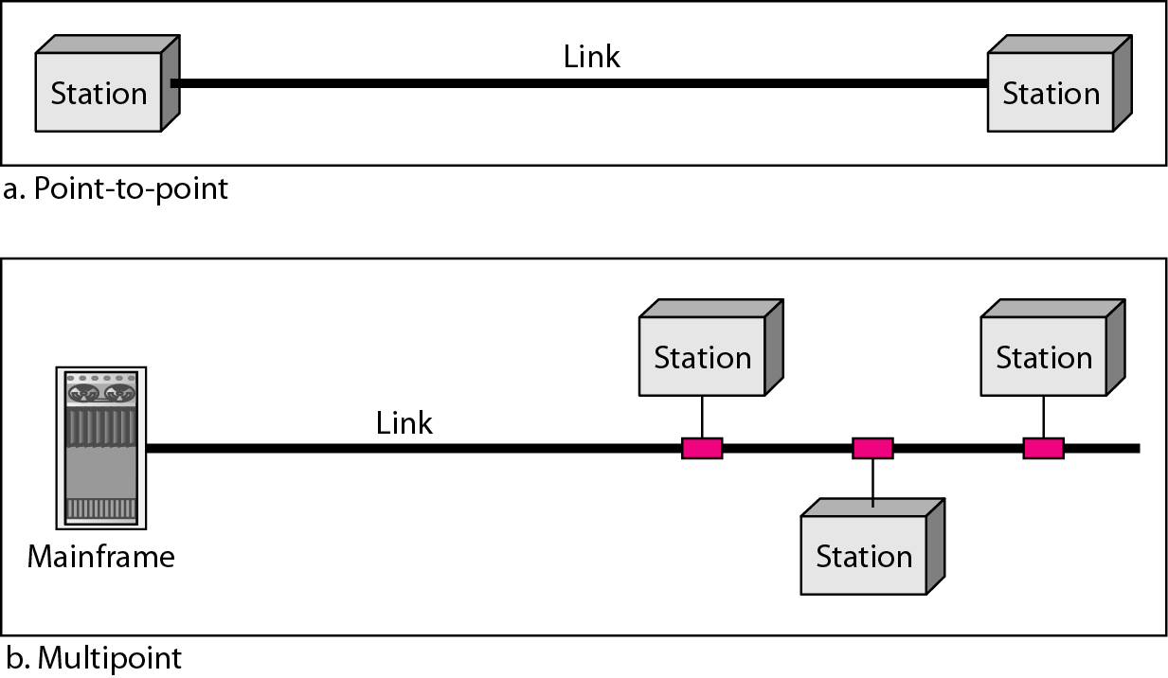
Computer networks
A network is a set of devices (often referred to as nodes) connected by communication links. A node can be a computer, printer, or any other device capable of sending and/or receiving data generated by other nodes on the network.
Types of connections

Slide 29
Computer networks
Distributed Processing
Most networks use distributed processing, in which a task is divided among multiple computers.
Instead of one single large machine being responsible for all aspects of a process, separate computer (usually a personal computer or workstation) handle a subset.

Slide 30
Computer networks
Network Criteria
Performance
Transmit time is the amount of time required for a message to travel from one device to another.
Response time is the elapsed time between an inquiry and a response.
depends on
the number of users,
the type of transmission medium,
the capabilities of the connected hardware,
and the efficiency of the software.
evaluated by two networking metrics: throughput and delay.

Slide 31
Computer networks
Network Criteria
Reliability
the frequency of failure,
the time it takes a link to recover from a failure.
Security
protecting data from unauthorized access,
protecting data from damage and development,
and implementing policies and procedures for recovery from breaches and data losses.

Slide 32
Goals & Applications of Computer networking
Goals of networking
Resource sharing
High reliability
Saving Money
Interprocess Communication
Flexible access
Distribution of Process
Peer to Peer communication (equal)
Centralized communication (one)

Slide 33
Goals & Applications of Computer networking
Applications of networking
Accessing Remote Database
Virtual Access Communication Facility
Marketing & Sales
Financial Services
Manufacturing
E-messages
Direct Services
Teleconferencing
Cable TV

Slide 34
Categories of Computer network
Personal Area Network (PAN) :
PAN is the most basic type of computer network.
This network is restrained to a single person, that is, communication between the computer devices is centred only to an individual’s work space.
PAN offers a network range of 10 meters from a person to the device providing communication. Examples of PAN devices are USB, computer, phone, tablet, printer, PDA, etc.
Examples Of Personal Area Network:
Body Area Network: Body Area Network is a network that moves with a person. For example, a mobile network moves with a person. Suppose a person establishes a network connection and then creates a connection with another device to share the information.

Slide 35
Categories of Computer network
Offline Network: An offline network can be created inside the home, so it is also known as a home network. A home network is designed to integrate the devices such as printers, computer, television but they are not connected to the internet.
Small Home Office: It is used to connect a variety of devices to the internet and to a corporate network using a VPN

Slide 36
Types of Networks (CO1)
2. LAN
A LAN is a computer network that connects computers together through a common communication path, contained within a limited area, that is, locally.
It is usually privately owned and links the devices in a single office, building, or campus for sharing of resources.
This type of network can be utilized to connect devices throughout one building or even 2-3 buildings depending on the proximity to each other. Whether your office location utilizes wired or wireless connection, it’s almost surely using a LAN connection.
It is less costly as it is built with inexpensive hardware such as hubs, network adapters, and Ethernet cables.
The data is transferred at an extremely faster rate (10 million bits per second or higher) in Local Area Network and it provides higher security.

Slide 37
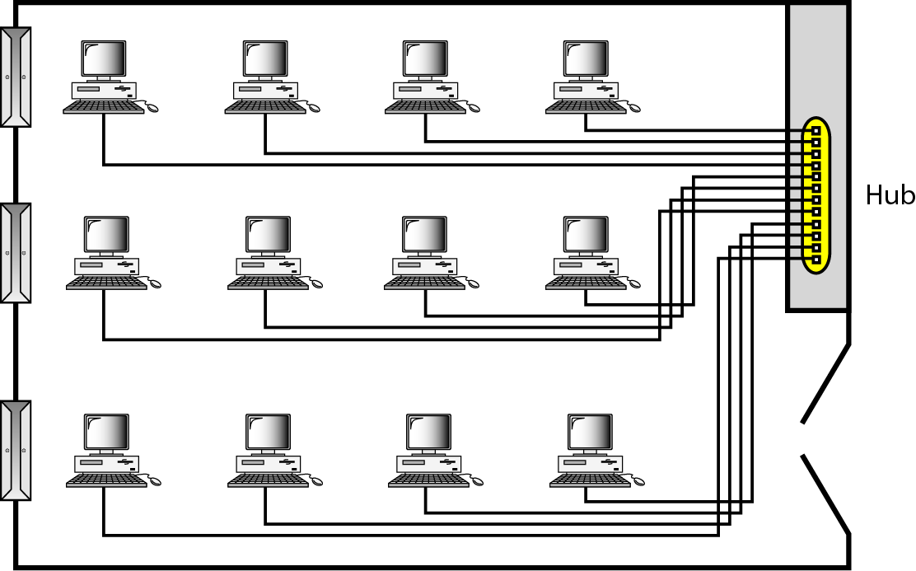
Types of Networks (CO1)

Slide 38
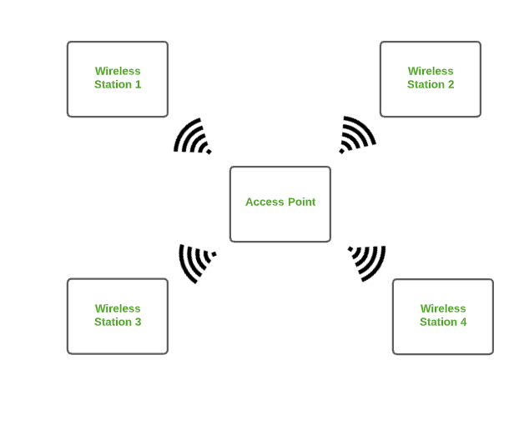
Types of Networks (CO1)
3. WLAN
WLAN is a type of computer network that acts as a local area network but makes use of wireless network technology like Wi-Fi. This network doesn’t allow devices to communicate over physical cables like in LAN but allows devices to communicate wirelessly.
The most common example of WLAN is Wi-Fi.

Slide 39
Types of Networks (CO1)
4. MAN
A metropolitan area network is a network that covers a larger geographic area by interconnecting a different LAN through a telephone exchange line to form a larger network.
This network has a size between a LAN and a WAN. It normally covers the area inside a town or a city.
It is designed for customers who need a high-speed connectivity, normally to the Internet, and have endpoints spread over a city or part of city.
Government agencies use MAN to connect to the citizens and private industries.
The most widely used protocols in MAN are RS-232, Frame Relay, ATM, ISDN, OC-3, ADSL, etc.
Examples of MAN are networking in towns, cities, a single large city, large area within multiple buildings, etc.

Slide 40
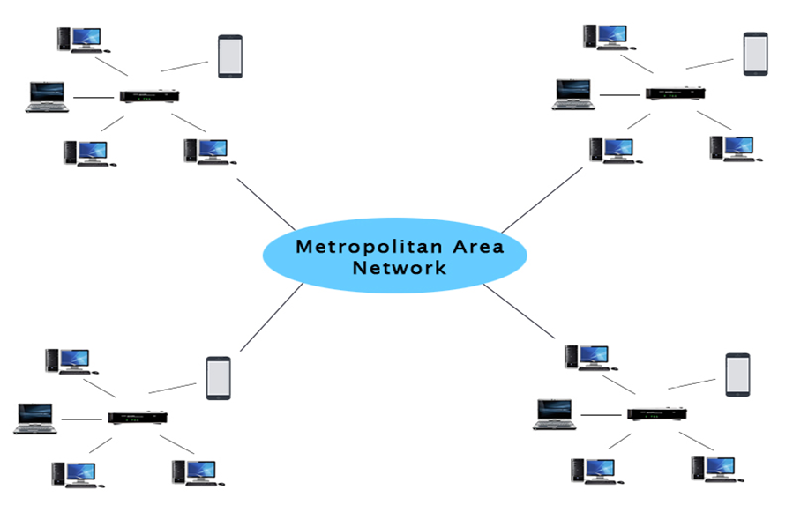
Types of Networks (CO1)
A MAN spans distances of approximately 100 miles; therefore, it is suitable for connecting devices and LANs in a metropolitan area.
MAN speeds are typically 100 Mbps or higher.
The most commonly implemented MAN is the fiber distributed data interface (FDDI). It operates at 100 Mbps over fiber optic cable for distances up to 200 kilometers.

Slide 41
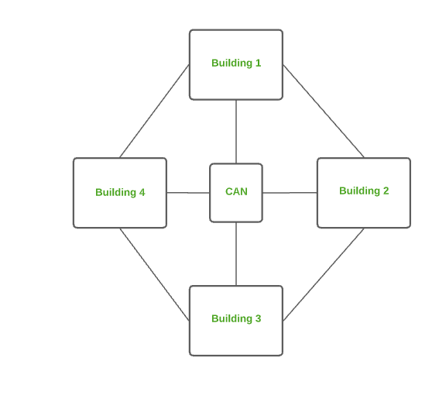
Types of Networks (CO1)
5. CAN
CAN is bigger than a PAN but smaller than a MAN.
This network covers a limited geographical area that is, it spreads across several buildings within the campus.
Examples of CAN are networks that cover schools, colleges, buildings, etc.

Slide 42
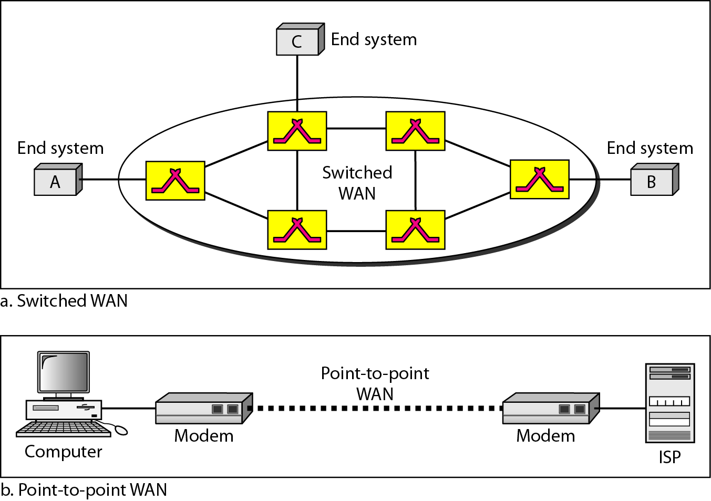
Types of Networks (CO1)
6. WAN
A wide area network (WAN) provides long-distance transmission of data, image, audio, and video information over large geographic areas that may comprise a country, a continent, or even the whole world
The most common example of WAN is the Internet.

Slide 43
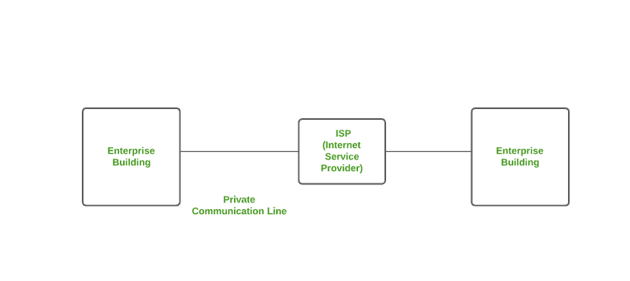
Types of Networks (CO1)
7. Enterprise Private Network (EPN) :
EPN is a type of computer network mostly used by businesses that want a secure connection over various locations to share computer resources.

Slide 44
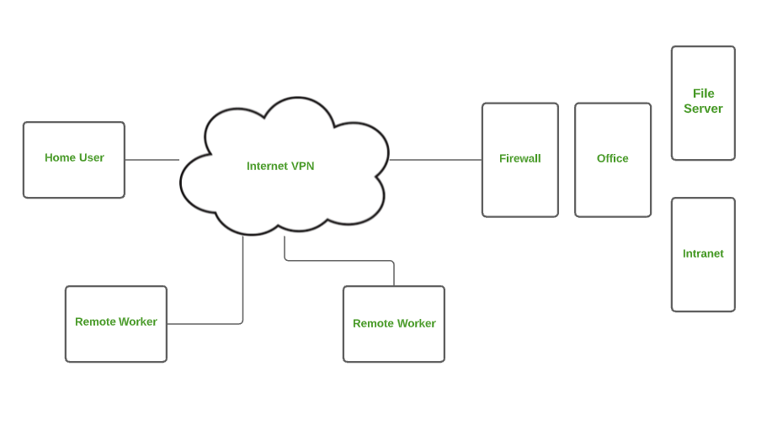
Types of Networks (CO1)
Virtual Private Network (VPN) :
A VPN is a type of computer network that extends a private network across the internet and lets the user send and receive data as if they were connected to a private network even though they are not.
Through a virtual point-to-point connection users can access a private network remotely.
VPN protects you from malicious sources by operating as a medium that gives you a protected network connection.

Slide 45
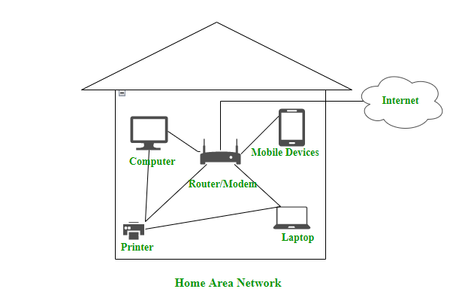
Types of Networks (CO1)
9. Home Area Network (HAN) :
Many of the houses might have more than a computer. To interconnect those computers and with other peripheral devices, a network should be established similar to the local area network (LAN) within that home.
Such a type of network that allows a user to interconnect multiple computers and other digital devices within the home is referred to as Home Area Network (HAN). It supports both wired and wireless communication.

Slide 46
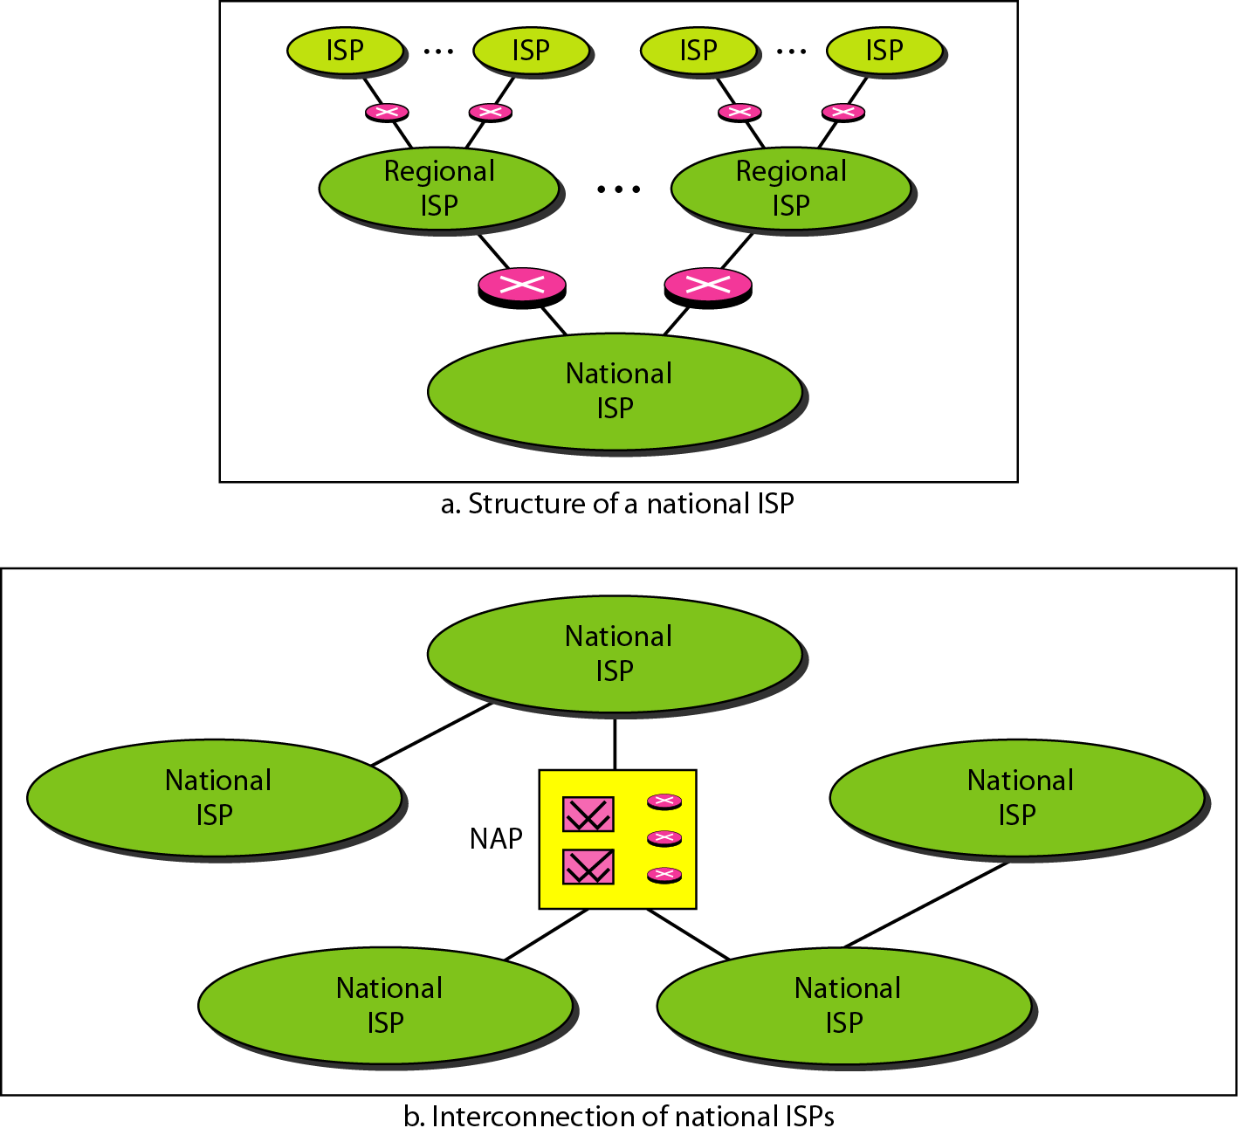
Internet(CO1)
When two or more networks are connected, they become an internetwork, or internet.

Slide 47
Computer Network Architecture(CO1)
Computer Network Architecture is defined as the physical and logical design of the software, hardware, protocols, and media of the transmission of data.
Simply we can say that how computers are organized and how tasks are allocated to the computer.
The two types of network architectures are used:
Peer-To-Peer network
Client/Server network

Slide 48
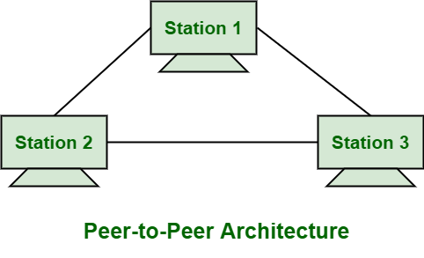
Computer Network Architecture(CO1)
Peer-To-Peer network:
Peer-To-Peer network is a network in which all the computers are linked together with equal privilege and responsibilities for processing the data.
Peer-To-Peer network is useful for small environments, usually up to 10 computers.
Peer-To-Peer network has no dedicated server.
Special permissions are assigned to each computer for sharing the resources, but this can lead to a problem if the computer with the resource is down.

Slide 49
Computer Network Architecture(CO1)
Advantages Of Peer-To-Peer Network:
It is less costly as it does not contain any dedicated server.
If one computer stops working but, other computers will not stop working.
It is easy to set up and maintain as each computer manages itself.
Disadvantages Of Peer-To-Peer Network:
In the case of Peer-To-Peer network, it does not contain the centralized system . Therefore, it cannot back up the data as the data is different in different locations.
It has a security issue as the device is managed itself.

Slide 50
Computer Network Architecture(CO1)
Client/Server network:
Client/Server network is a network model designed for the end users called clients, to access the resources such as songs, video, etc. from a central computer known as Server.
The central controller is known as a server while all other computers in the network are called clients.
A server performs all the major operations such as security and network management.
A server is responsible for managing all the resources such as files, directories, printer, etc.
All the clients communicate with each other through a server. For example, if client1 wants to send some data to client 2, then it first sends the request to the server for the permission. The server sends the response to the client 1 to initiate its communication with the client 2.

Slide 51
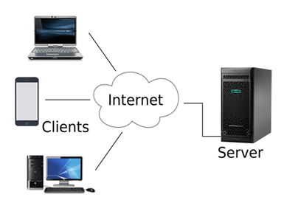
Computer Network Architecture(CO1)

Slide 52
Computer Network Architecture(CO1)
Advantages of Client/Server Network:
A Client/Server network contains the centralized system. Therefore we can back up the data easily.
A Client/Server network has a dedicated server that improves the overall performance of the whole system.
Security is better in Client/Server network as a single server administers the shared resources.
It also increases the speed of the sharing resources.
Disadvantages of Client/Server Network:
Client/Server network is expensive as it requires the server with large memory.
A server has a Network Operating System(NOS) to provide the resources to the clients, but the cost of NOS is very high.
It requires a dedicated network administrator to manage all the resources.

Slide 53
OSI & TCP/IP models (CO1)
Topic Objective
To understand the OSI and TCP/IP models
Differences between two and the protocols supported
Recap of previous topic
The basic networking layout and architecture were studied
Data flow mode supported

Slide 54
Layered Network Architecture(CO1)
Layered Architecture
The main aim of the layered architecture is to divide the design into small pieces.
Each lower layer adds its services to the higher layer to provide a full set of services to manage communications and run the applications.
It provides modularity and clear interfaces, i.e., provides interaction between subsystems.
It ensures the independence between layers by providing the services from lower to higher layer without defining how the services are implemented. Therefore, any modification in a layer will not affect the other layers.
The number of layers, functions, contents of each layer will vary from network to network. However, the purpose of each layer is to provide the service from lower to a higher layer and hiding the details from the layers of how the services are implemented.

Slide 55
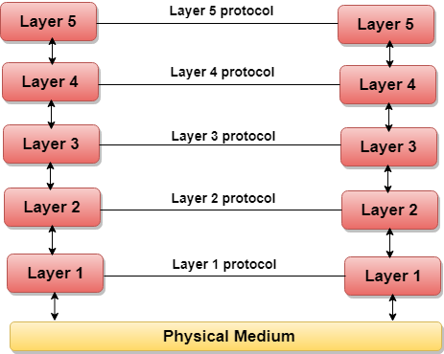
Layered Network Architecture(CO1)
Basic elements of layered architecture:
Service: It is a set of actions that a layer provides to the higher layer.
Protocol: It defines a set of rules that a layer uses to exchange the information with peer entity. These rules mainly concern about both the contents and order of the messages used.
Interface: It is a way through which the message is transferred from one layer to another layer.
5 layered Architecture

Slide 56
Layered Network Architecture(CO1)
In case of layered architecture, no data is transferred from layer n of one machine to layer n of another machine. Instead, each layer passes the data to the layer immediately just below it, until the lowest layer is reached.
Below layer 1 is the physical medium through which the actual communication takes place.
In a layered architecture, unmanageable tasks are divided into several small and manageable tasks.
The data is passed from the upper layer to lower layer through an interface. A Layered architecture provides a clean-cut interface so that minimum information is shared among different layers. It also ensures that the implementation of one layer can be easily replaced by another implementation.

Slide 57
Layered Network Architecture(CO1)
Why do we require Layered architecture?
1. Divide-and-conquer approach: Divide-and-conquer approach makes a design process in such a way that the unmanageable tasks are divided into small and manageable tasks. In short, we can say that this approach reduces the complexity of the design.
2. Modularity: Layered architecture is more modular. Modularity provides the independence of layers, which is easier to understand and implement.
3. Easy to modify: It ensures the independence of layers so that implementation in one layer can be changed without affecting other layers.
4. Easy to test: Each layer of the layered architecture can be analyzed and tested individually.

Slide 58
OSI Model (CO1)
OSI Model:
OSI stands for Open System Interconnection is a reference model that describes how information from a software application in one computer moves through a physical medium to the software application in another computer.
OSI consists of seven layers, and each layer performs a particular network function.
OSI model was developed by the International Organization for Standardization (ISO) in 1984, and it is now considered as an architectural model for the inter-computer communications.
OSI model divides the whole task into seven smaller and manageable tasks. Each layer is assigned a particular task.
Each layer is self-contained, so that task assigned to each layer can be performed independently.

Slide 59
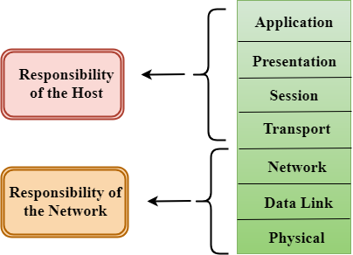
OSI Model (CO1)
Characteristics of OSI Model:

Slide 60
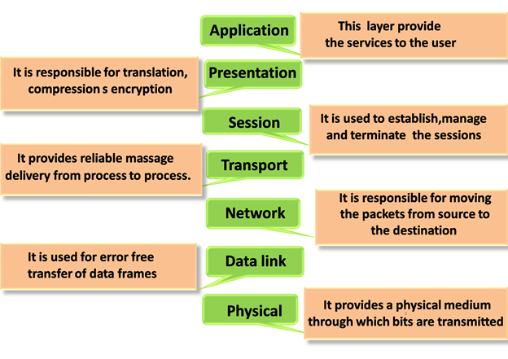
OSI Model(CO1)
Functions of OSI Layers:

Slide 61
OSI Model (CO1)
Physical layer - coordinates the functions required to carry a bit stream over a physical medium
Physical characteristics of interfaces and medium
Representation of bits, Data rate , Synchronization of bits
Line configuration
Physical topology
Transmission mode
Data Link Layer - transforms the physical layer, a raw transmission facility, to a reliable link
Framing
Physical addressing
Flow control
Error control
Access control

Slide 62
OSI Model
Network Layer: responsible for the source-to-destination delivery of a packet, possibly across multiple networks
Logical addressing
Routing
Transport Layer : process-to-process delivery of the entire message
Service-point addressing
Segmentation and reassembly
Connection control
Flow control
Error control
Session Layer: establishes, maintains, and synchronizes the interaction among communicating systems
Dialog control
Synchronization

Slide 63
OSI Model
Presentation Layer : concerned with the syntax and semantics of the information exchanged between two systems
Translation
Encryption
Compression
Application Layer : enables the user to access the network
Network virtual terminal
File transfer, access, and management
Mail services
Directory services

Slide 64
TCP/IP Model
The TCP/IP model was developed prior to the OSI model. It is not exactly similar to the OSI model.
The TCP/IP model consists of five layers: the application layer, transport layer, network layer, data link layer and physical layer.
The first four layers provide physical standards, network interface, internetworking, and transport functions that correspond to the first four layers of the OSI model and these four layers are represented in TCP/IP model by a single layer called the application layer.
TCP/IP is a hierarchical protocol made up of interactive modules, and each of them provides specific functionality.
Here, hierarchical means that each upper-layer protocol is supported by two or more lower-level protocols.

Slide 65
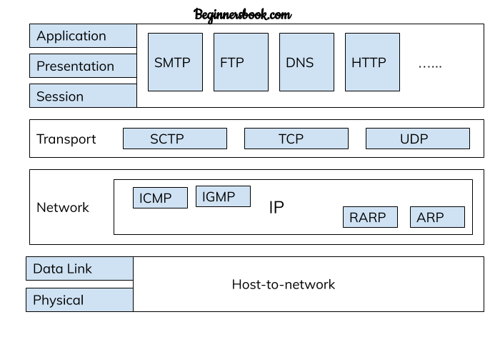
TCP/IP Model
Functions of TCP/IP layers:

Slide 66
TCP/IP Model
Network Access Layer
A network layer is the lowest layer of the TCP/IP model.
A network layer is the combination of the Physical layer and Data Link layer defined in the OSI reference model.
It defines how the data should be sent physically through the network.
This layer is mainly responsible for the transmission of the data between two devices on the same network.
The functions carried out by this layer are encapsulating the IP datagram into frames transmitted by the network and mapping of IP addresses into physical addresses.
The protocols used by this layer are Ethernet, token ring, FDDI, X.25, frame relay.

Slide 67
TCP/IP Model
Internet Layer:
An internet layer is the second layer of the TCP/IP model.
An internet layer is also known as the network layer.
The main responsibility of the internet layer is to send the packets from any network, and they arrive at the destination irrespective of the route they take.
Transport Layer:
The transport layer is responsible for the reliability, flow control, and correction of data which is being sent over the network.
The two protocols used in the transport layer are User Datagram protocol and Transmission control protocol.

Slide 68
TCP/IP Model
Application Layer
An application layer is the topmost layer in the TCP/IP model.
It is responsible for handling high-level protocols, issues of representation.
This layer allows the user to interact with the application.
When one application layer protocol wants to communicate with another application layer, it forwards its data to the transport layer.
There is an ambiguity occurs in the application layer. Every application cannot be placed inside the application layer except those who interact with the communication system. For example: text editor cannot be considered in application layer while web browser using HTTP protocol to interact with the network where HTTP protocol is an application layer protocol.

Slide 69
Comparison between OSI and TCP/IP(CO1)
TCP/IP
OSI
TCP refers to Transmission Control Protocol. | OSI refers to Open Systems Interconnection.
TCP/IP has 4 layers. | OSI has 7 layers.
TCP/IP is more reliable | OSI is less reliable
TCP/IP does not have very strict boundaries. | OSI has strict boundaries
TCP/IP follow a horizontal approach. | OSI follows a vertical approach.
TCP/IP uses both session and presentation layer in the application layer itself. | OSI uses different session and presentation layers.
TCP/IP developed protocols then model. | OSI developed model then protocol.

Slide 70
Comparison between OSI and TCP/IP
TCP/IP
OSI
TCP does not clearly distinguish between service, protocols and interfaces | OSI has explicit distinction between these.
Specific protocols | protocols are better hidden
Protocol based model | Protocols can be replaced as technology changes
Description of the protocols | General model
Protocols do not fit in the function | Protocols do not fit in the function

Slide 71
Networking Devices and Communication
Hardware devices that are used to connect computers, printers, fax machines and other electronic devices to a network are called network devices. These devices transfer data in a fast, secure and correct way over same or different networks.
1. Modem: Modem is a device that enables a computer to send or receive data over telephone or cable lines. The data stored on the computer is digital whereas a telephone line or cable wire can transmit only analog data. The main function of the modem is to convert digital signal into analog and vice versa. Modem is a combination of two devices: modulator and demodulator. The modulator converts digital data into analog data when the data is being sent by the computer. The demodulator converts analog data signals into digital data when it is being received by the computer.

Slide 72
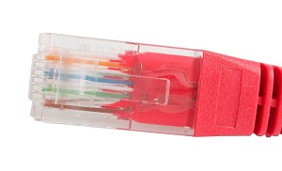
Networking Devices and Communication
2. RJ45 Connector:
RJ45 is the acronym for Registered Jack 45. RJ45 connector is an 8-pin jack used by devices to physically connect to Ethernet based local area networks (LANs).
Ethernet is a technology that defines protocols for establishing a LAN.
The cable used for Ethernet LANs are twisted pair ones and have RJ45 connector pins at both ends.
These pins go into the corresponding socket on devices and connect the device to the network.

Slide 73
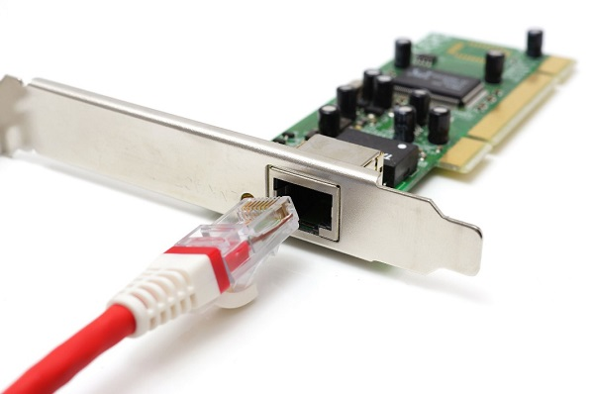
Networking Devices and Communication
3. Ethernet Card:
Ethernet card, also known as network interface card (NIC), is a hardware component used by computers to connect to Ethernet LAN and communicate with other devices on the LAN. The earliest Ethernet cards were external to the system and needed to be installed manually. In modern computer systems, it is an internal hardware component. The NIC has RJ45 socket where network cable is physically plugged in.

Slide 74
Networking Devices and Communication
4. Repeater:
A repeater operates at the physical layer. Its job is to regenerate the signal over the same network before the signal becomes too weak or corrupted so as to extend the length to which the signal can be transmitted over the same network.
An important point to be noted about repeaters is that they do not amplify the signal.
When the signal becomes weak, they copy the signal bit by bit and regenerate it at the original strength. It is a 2 port device.
5. Hub:
A hub is a physical device used to join multiple devices on the same LAN. For example, a laptop, desktop computer and printer can connect into a hub's ports with Ethernet cables and be part of the same local network.

Slide 75
Networking Devices and Communication
Unlike a bridge, router or switch, a hub broadcasts messages it receives from one port to all remaining ports without examining the frames or isolating the message for the intended destination.
A hub must connect to a router or switch in order to communicate outside its LAN. Hub devices can also connect to each other to expand the overall network.
A hub can be active, passive or intelligent.
Active hubs act as repeaters to boost or repair the signal of an incoming message before they broadcast it to the rest of the ports.
Passive hubs do not boost message signals, simply providing connectivity for devices on its ports.
Intelligent hubs have management and monitoring capabilities to identify potential issues with connected devices.

Slide 76
Networking Devices and Communication
7. Bridge:
A network bridge acts as an interconnection between two or more LANs, essentially creating a single domain from separate LANs.
A bridge aggregates the partitioned network segments and controls traffic that moves between them.
A transparent bridge interconnects LANs that use the same protocol suite, while a translation bridge joins LANs that use different protocols.
Bridge devices have switching capabilities, with which they forward incoming data frames by examining media access control (MAC) addresses.
With each frame it receives, a bridge builds a lookup table of MAC addresses and port locations.
The bridge references this table to determine whether to forward a frame along or discard it, which happens when a MAC address is not within the bridge's domain.

Slide 77
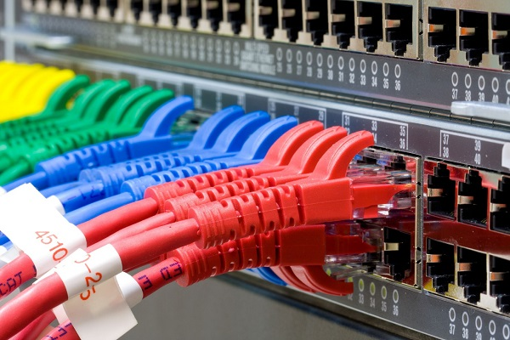
Networking Devices and Communication
6. Switch:
Switch is a network device that connects other devices to Ethernet networks through twisted pair cables.
It uses packet switching technique to receive, store and forward data packets on the network.

Slide 78
Networking Devices and Communication
The switch maintains a list of network addresses of all the devices connected to it.
On receiving a packet, it checks the destination address and transmits the packet to the correct port.
Before forwarding, the packets are checked for collision and other network errors. The data is transmitted in full duplex mode.
Data transmission speed in switches can be double that of other network devices like hubs used for networking. This is because switch shares its maximum speed with all the devices connected to it. This helps in maintaining network speed even during high traffic.
In fact, higher data speeds are achieved on networks through use of multiple switches.

Slide 79
Networking Devices and Communication
8. Router:
A router is a network layer hardware device that transmits data from one LAN to another if both networks support the same set of protocols.
So, a router is typically connected to at least two LANs and the internet service provider (ISP). It receives its data in the form of packets, which are data frames with their destination address added.
Router also strengthens the signals before transmitting them. That is why it is also called repeater.
Routing Table
A router reads its routing table to decide the best available route the packet can take to reach its destination quickly and accurately. The routing table may be of these two types −
1. Static − In a static routing table the routes are fed manually. So it is suitable only for very small networks that have maximum two to three routers.

Slide 80
Networking Devices and Communication
2. Dynamic − In a dynamic routing table, the router communicates with other routers through protocols to determine which routes are free. This is suited for larger networks where manual feeding may not be feasible due to large number of routers.
9. Gateway:
Gateway is a network device used to connect two or more dissimilar networks. In networking parlance, networks that use different protocols are dissimilar networks.
A gateway usually is a computer with multiple NICs connected to different networks.
A gateway can also be configured completely using software. As networks connect to a different network through gateways, these gateways are usually hosts or end points of the network.

Slide 81
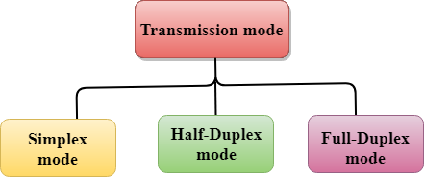
Modes of Transmission
The way in which data is transmitted from one device to another device is known as transmission mode.
The transmission mode is also known as the communication mode.
Each communication channel has a direction associated with it, and transmission media provide the direction. Therefore, the transmission mode is also known as a directional mode.
The transmission mode is defined in the physical layer.
The Transmission mode is divided into three categories:
1. Simplex mode
2. Half-duplex mode
3. Full-duplex mode

Slide 82

Modes of Transmission
Simplex mode:
In Simplex mode, the communication is unidirectional, i.e., the data flow in one direction. A device can only send the data but cannot receive it or it can receive the data but cannot send the data.
This transmission mode is not very popular as mainly communications require the two-way exchange of data. The simplex mode is used in the business field as in sales that do not require any corresponding reply.
The radio station is a simplex channel as it transmits the signal to the listeners but never allows them to transmit back.

Slide 83
Modes of Transmission
Keyboard and Monitor are the examples of the simplex mode as a keyboard can only accept the data from the user and monitor can only be used to display the data on the screen.
Advantage:
In simplex mode, the station can utilize the entire bandwidth of the communication channel, so that more data can be transmitted at a time.
Disadvantage:
Communication is unidirectional, so it has no inter communication between devices.

Slide 84
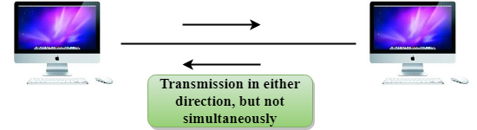
Modes of Transmission
2. Half-duplex mode:
In a Half-duplex channel, direction can be reversed, i.e., the station can transmit and receive the data as well.
Messages flow in both the directions, but not at the same time.
The entire bandwidth of the communication channel is utilized in one direction at a time.
In half-duplex mode, it is possible to perform the error detection, and if any error occurs, then the receiver requests the sender to retransmit the data.

Slide 85
Modes of Transmission
A Walkie-talkie is an example of the Half-duplex mode. In Walkie-talkie, one party speaks, and another party listens. After a pause, the other speaks and first party listens. Speaking simultaneously will create the distorted sound which cannot be understood.
Advantage
In half-duplex mode, both the devices can send and receive the data and also can utilize the entire bandwidth of the communication channel during the transmission of data.
Disadvantage:
In half-duplex mode, when one device is sending the data, then another has to wait, this causes the delay in sending the data at the right time.

Slide 86

Modes of Transmission
3. Full-duplex mode:
In Full duplex mode, the communication is bi-directional, i.e., the data flow in both the directions.
Both the stations can send and receive the message simultaneously.
Full-duplex mode has two simplex channels. One channel has traffic moving in one direction, and another channel has traffic flowing in the opposite direction.
The Full-duplex mode is the fastest mode of communication between devices.

Slide 87
Modes of Transmission
The most common example of the full-duplex mode is a telephone network. When two people are communicating with each other by a telephone line, both can talk and listen at the same time.
Advantage of Full-duplex mode:
Both the stations can send and receive the data at the same time.
Disadvantage of Full-duplex mode:
If there is no dedicated path exists between the devices, then the capacity of the communication channel is divided into two parts.

